Slide 1
Digital Signal Processing Introduction
Abu saleh Musa Miah
Lecturer, Dept. of CSE, BAUST, Bangladesh email: musa@baust.edu.bd, tel: +88-01727-786600 web: www.baust.edu.bd/cse

Slide 2
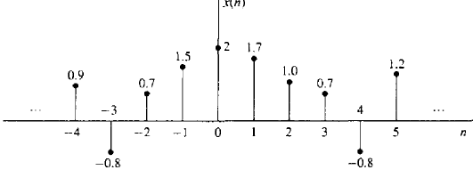
DISCRETE-TIME SIGNALS
Discrete-time signal x ( n ) is a function of an independent variable that is an integer.
It is graphically represented as in Fig. 2.1. It is important to note that a discrete-time signal is not defined at instants between two successive samples.
Also, it is incorrect to think that x ( n ) is equal to zero if n is not an integer. Simply, the signal x ( n ) is not defined for noninteger values of n.
Figure 21 Graphical representation of a discrete-time signal.

Slide 3
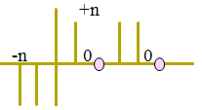
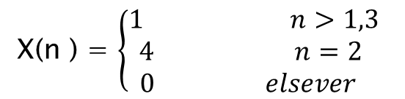
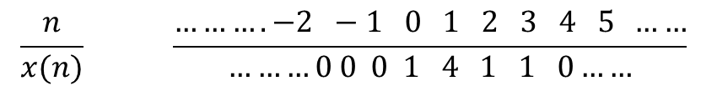
Representation Digital Signal
Besides the graphical representation of a discrete-time signal or sequence as illustrated in Fig. 2.1. there are some alternative representations that are often more convenient to use. These are
Functional representation :
X(n ) = $\left\{\begin{aligned}1 n>1,3 \\ 4 n=2 \\ 0 elsever \end{aligned}\right.$
+n
Tabular representation :
$$\frac{n}{x(n)} \frac{……….−2 −1 0 1 2 3 4 5 ……}{………0 0 0 1 4 1 1 0……}$$

Slide 4
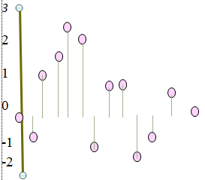
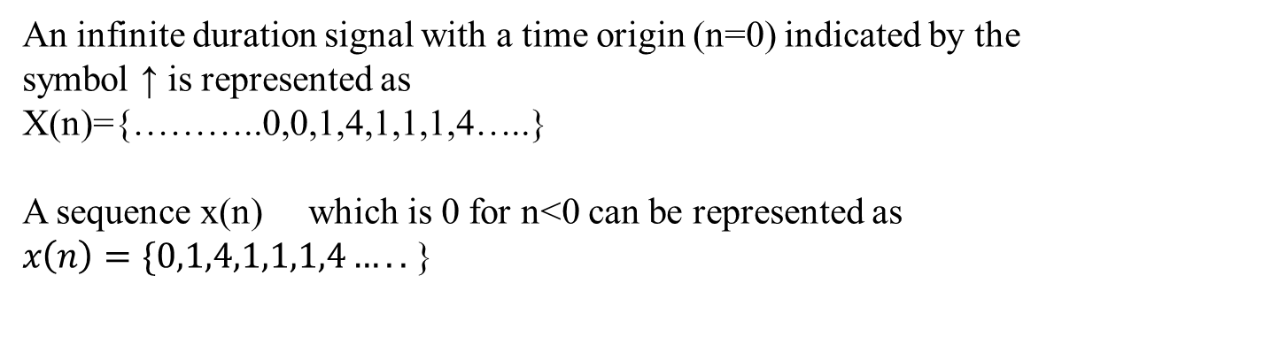
Representation Digital Signal
Sequence representation :
An infinite duration signal with a time origin (n=0) indicated by the
symbol ↑ is represented as
X(n)={………..0,0,1,4,1,1,1,4…..}
A sequence x(n) which is 0 for n<0 can be represented as
$x\left(n\right)=\{0,1,4,1,1,1,4…..$ }
Graphical representation :
The time origin for the sequence x(n) is
understood to be the left most point in the
sequence where x(n) is 0 for n<0.
For finite representation n={0,1,4,1,1,1,4 }
which is a 7-point sequence.
+n

Slide 5
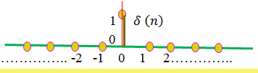

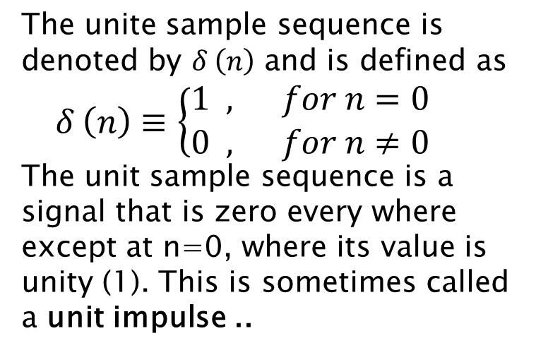
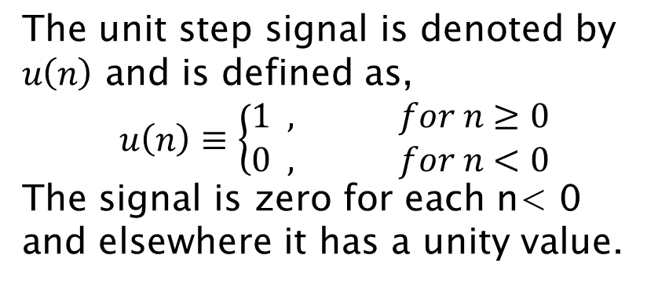
Some Elementary Discrete-Time Signals
Unite sample sequence?
The unite sample sequence is denoted by $δ \left(n\right)$ and is defined as
$δ \left(n\right)≡\left\{\begin{aligned}1 , for n=0 \\ 0 , for n≠0\end{aligned}\right.$
The unit sample sequence is a signal that is zero every where except at n=0, where its value is unity (1). This is sometimes called a unit impulse ..
The unit step signal is denoted by $u\left(n\right)$ and is defined as,
$$u\left(n\right)≡\left\{\begin{aligned}1 , for n≥0 \\ 0 , for n<0\end{aligned}\right.$$
The signal is zero for each n< 0 and elsewhere it has a unity value.
Unit step signal?

Slide 6
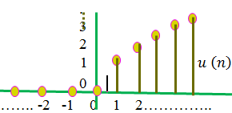
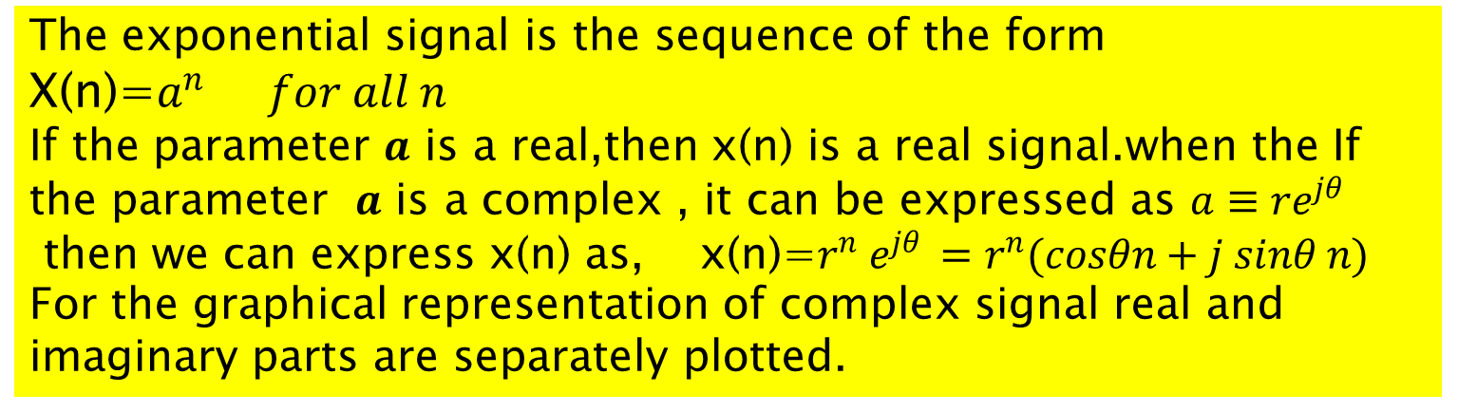
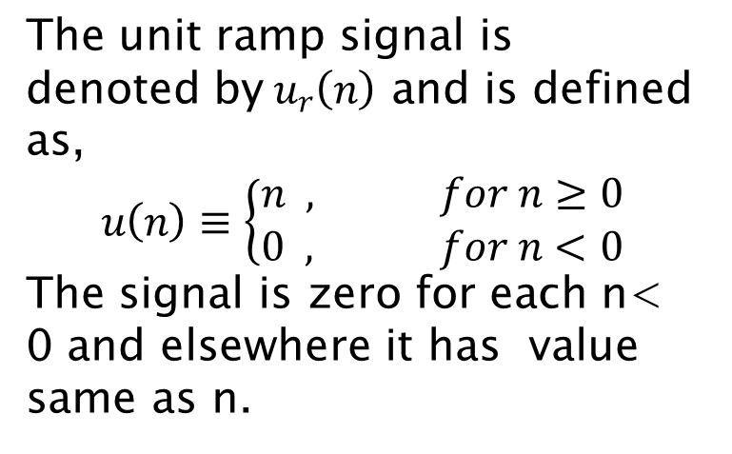
Some Elementary Discrete-Time Signals
Unit ramp signal?
The unit ramp signal is denoted by$u_{r}\left(n\right)$ and is defined as,
$$u\left(n\right)≡\left\{\begin{aligned}n , for n≥0 \\ 0 , for n<0\end{aligned}\right.$$
The signal is zero for each n< 0 and elsewhere it has value same as n.
Exponential signals ?
The exponential signal is the sequence of the form
X(n)=$a^{n} for all n$
If the parameter $a$ is a real,then x(n) is a real signal.when the If the parameter $a$ is a complex , it can be expressed as $a≡re^{jθ }$
then we can express x(n) as, x(n)=$r^{n} e^{jθ }=r^{n}(cosθn+j sinθ n)$
For the graphical representation of complex signal real and imaginary parts are separately plotted.

Slide 7
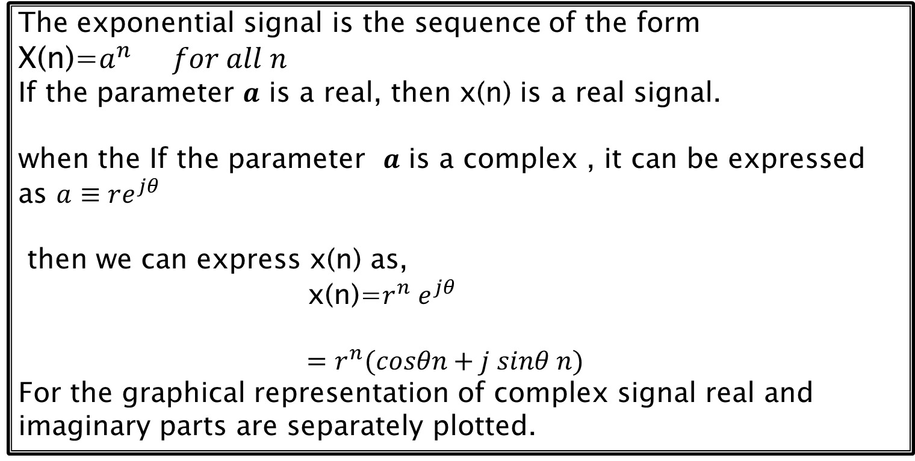
Some Elementary Discrete-Time Signals
Exponential signals ?
The exponential signal is the sequence of the form
X(n)=$a^{n} for all n$
If the parameter $a$ is a real, then x(n) is a real signal.
when the If the parameter $a$ is a complex , it can be expressed as $a≡re^{jθ }$
then we can express x(n) as,
x(n)=$r^{n} e^{jθ }$
$$=r^{n}(cosθn+j sinθ n)$$
For the graphical representation of complex signal real and imaginary parts are separately plotted.

Slide 8
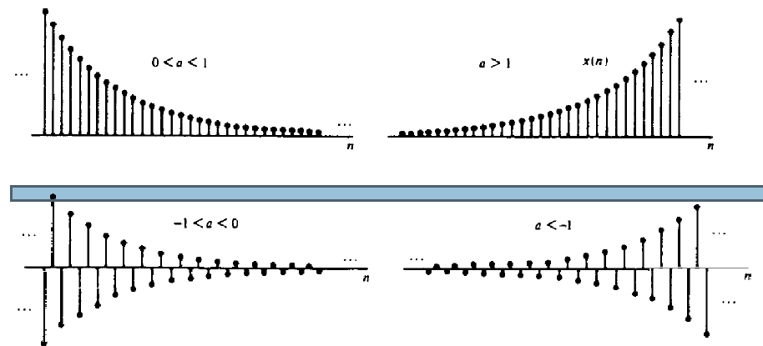
Some Elementary Discrete-Time Signals
Exponential signals ?
Figure 2.5 Graphical representation of exponential signals.

Slide 9
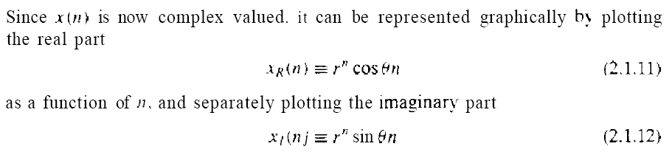
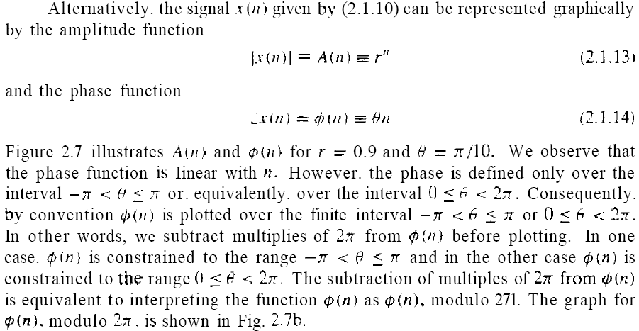
Signal Amplitude and Magnitude :

Slide 10
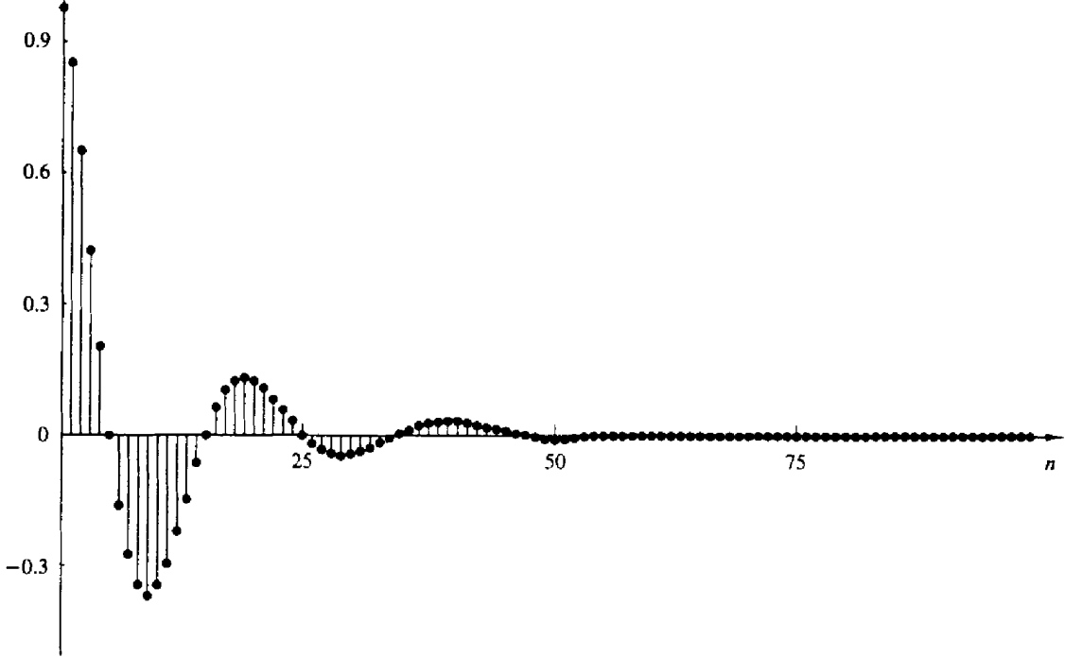
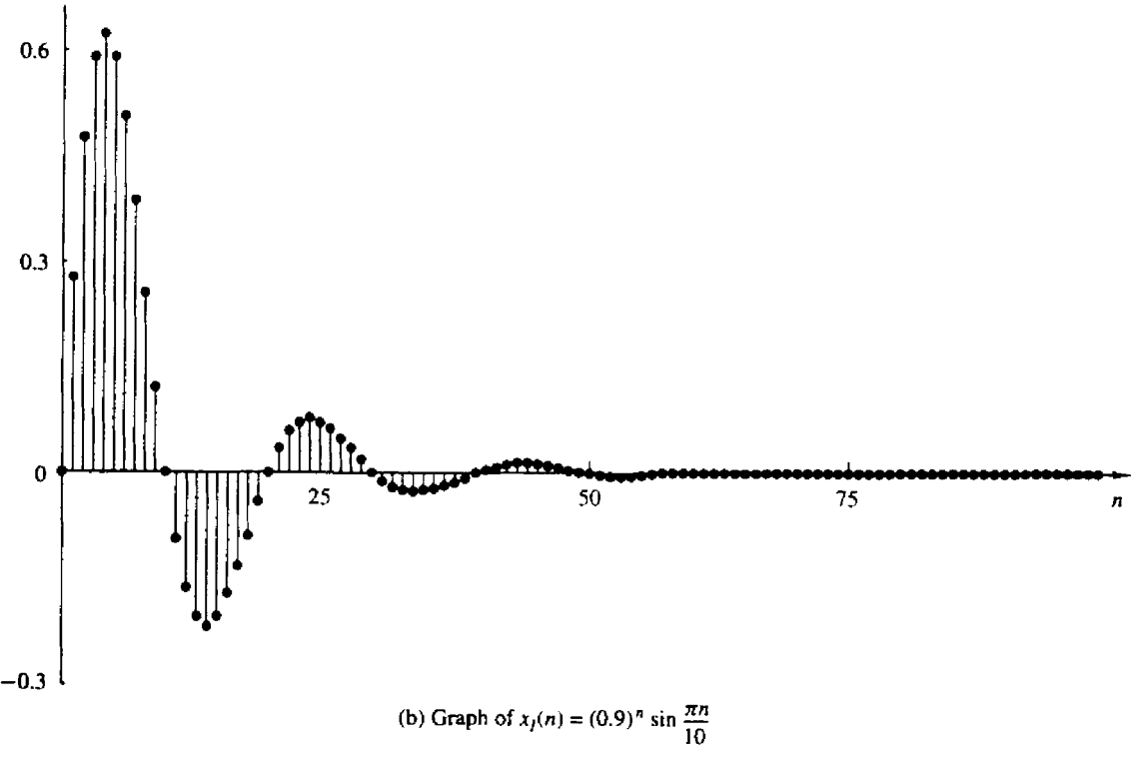
Signal Amplitude and Magnitude :

Slide 11
Signal Amplitude and Magnitude :
Amplitude: Amplitude of a variable is the measure of how far and in what direction, that variable differs from zero. It can be positive or negative. Amplitude: +A or -A.

Slide 12
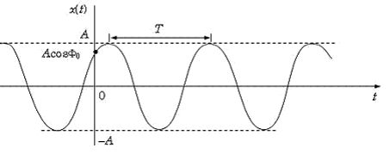
Amplitude & Magnitude of a signal

Slide 13
Magnitude:
It is the measure of how far, regardless of direction from zero.
Magnitude is the absolute value and always positive.
Magnitude:

Slide 14
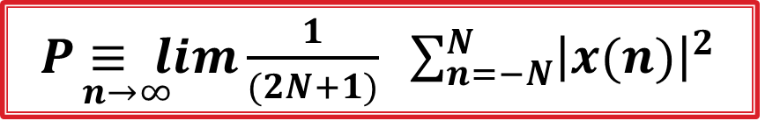
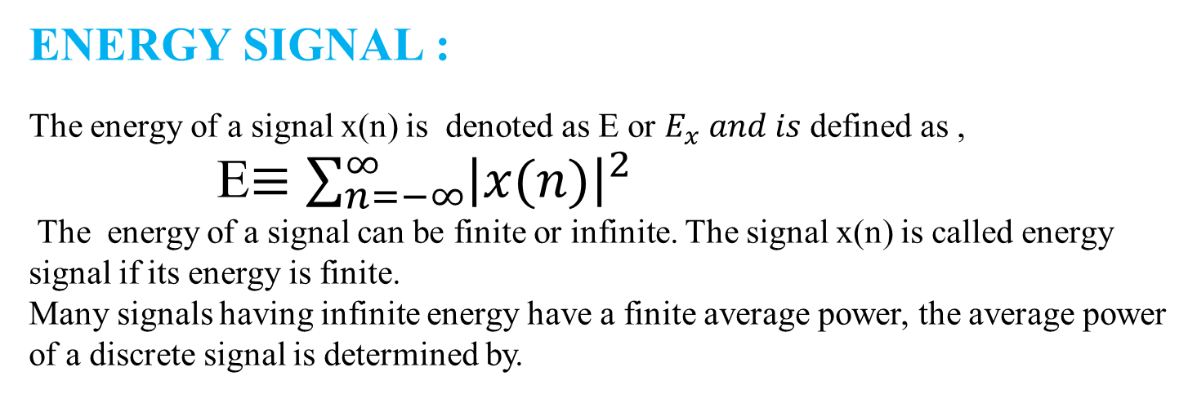
Classification of Discrete-Time Signals
we classify discrete-time signals according to a number of different characteristics.
Energy signals
power signals.
ENERGY SIGNAL :
The energy of a signal x(n) is denoted as E or $E_{x} and is$defined as ,
E$≡\sum_{n=−∞}^{∞}{{\left|x(n)\right|}^{2}}$
The energy of a signal can be finite or infinite. The signal x(n) is called energy signal if its energy is finite.
Many signals having infinite energy have a finite average power, the average power of a discrete signal is determined by.
$\underset{n→∞}{P≡ lim}{\frac{1}{(2N+1)}} \sum_{n=−N}^{N}{{\left|x(n)\right|}^{2}}$

Slide 15
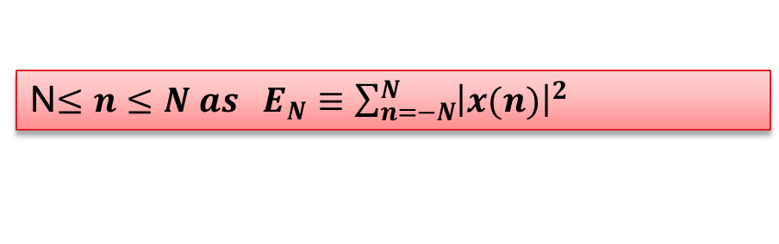
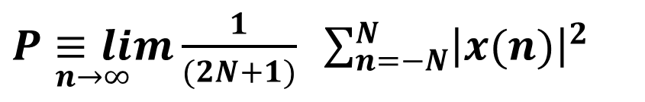
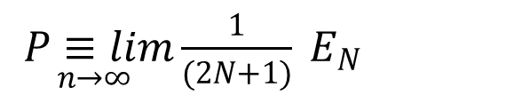
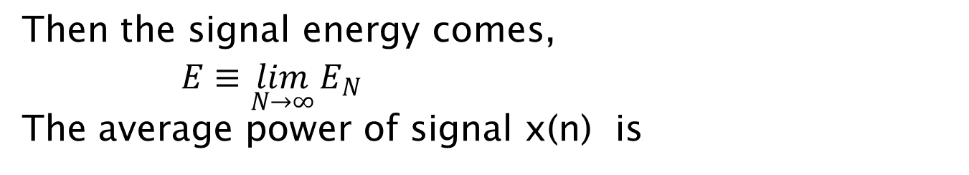
POWER SIGNAL
the average power of a discrete signal is determined by.
$\underset{n→∞}{P≡lim}{\frac{1}{(2N+1)}} \sum_{n=−N}^{N}{{\left|x(n)\right|}^{2}}$
We define the energy of a signal in the finite interval
N$≤n≤N as E_{N}≡\sum_{n=−N}^{N}{{\left|x(n)\right|}^{2}}$
Then the signal energy comes,
$E≡\lim_{N→∞}{E_{N}}$
The average power of signal x(n) is
$\underset{n→∞}{P≡lim}{\frac{1}{(2N+1)}} E_{N}$
If E is finite, P = 0 and if E is infinite the average power of the signal can be finite or infinite. If the signal average power P is finite and nonzero then the signal is called a power signal.
Determine the power and energy of unit step sequence
The average power of unit step sequence is

Slide 16
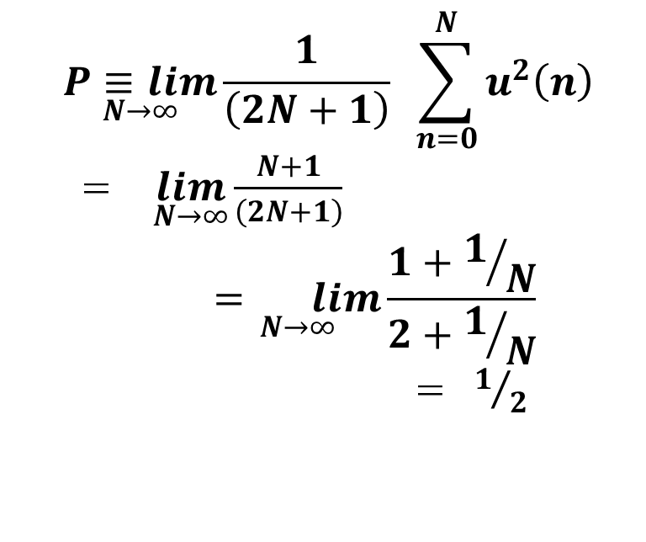
POWER SIGNAL
$$\underset{N→∞}{P≡lim}{\frac{1}{\left(2N+1\right)}} \sum_{n=0}^{N}{u^{2}\left(n\right)}$$
= $\lim_{N→∞}{\frac{N+1}{\left(2N+1\right)}}$
$$\underset{N→∞}{= lim}{\frac{1+1/N}{2+1/N}}$$
=${ 1}/2$
The unit step sequence is a power signal having an infinite energy.

Slide 17
Periodic & A Non-periodic Signals:
Periodic Signal:
Some signals repeat themselves over fixed intervals of time. Such signals are said to be periodic.
A signal is said to be periodic if it repeats itself after a fixed period T, i.e.
x(t) = x(t + T) for continuos
x(n) = x(n + N) for discrete
That is the signal repeats itself every T times (for continuous) or N samples (for discrete).

Slide 18
Periodic Signal

Slide 19
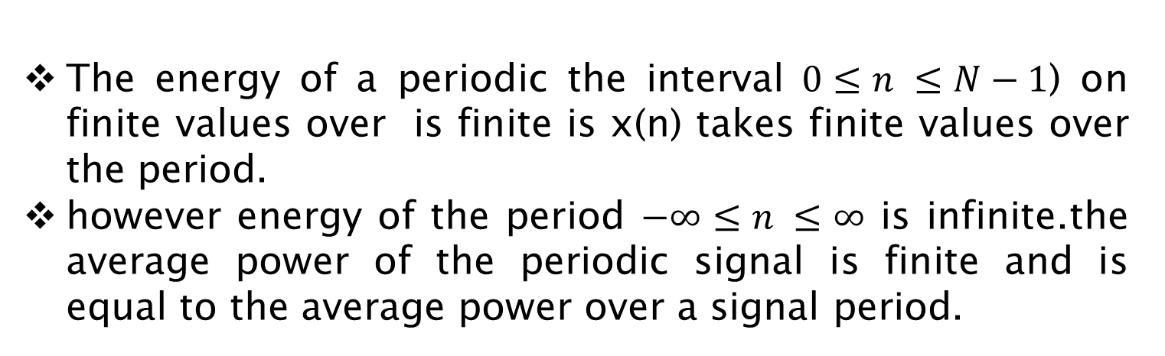
Discuss periodic signal and aperiodic signal?
The energy of a periodic the interval$0≤n ≤N−1$) on finite values over is finite is x(n) takes finite values over the period.
however energy of the period $−∞≤n ≤∞$ is infinite.the average power of the periodic signal is finite and is equal to the average power over a signal period.

Slide 20
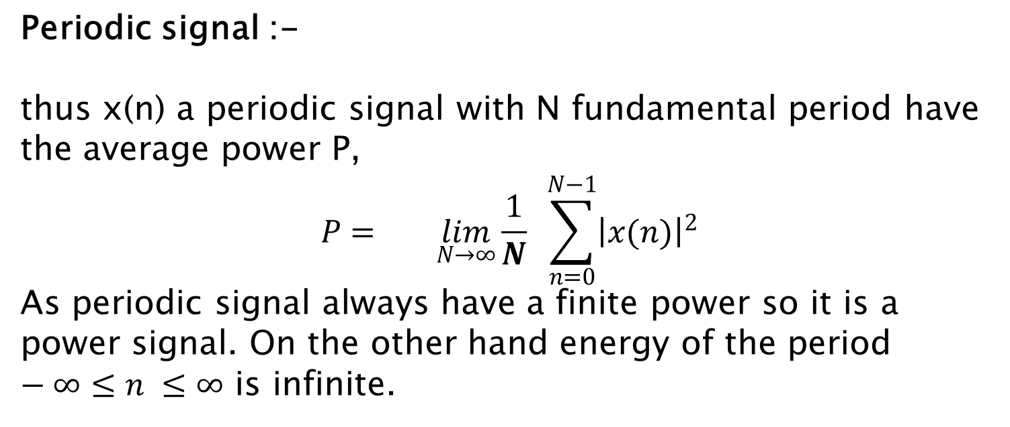
Discuss periodic signal and aperiodic signal?
Periodic signal :-
thus x(n) a periodic signal with N fundamental period have the average power P,
$$P= \lim_{N→∞}{\frac{1}{N}} \sum_{n=0}^{N−1}{{\left|x(n)\right|}^{2}}$$
As periodic signal always have a finite power so it is a power signal. On the other hand energy of the period $−∞≤n ≤∞$ is infinite.

Slide 21
Aperiodic (non- periodic) signal:
If the above equation is not satisfied, the signal is called aperiodic (non- periodic) signal.
Some signals repeat themselves over not fixed intervals of time. Such signals are said to be aperiodic or non-periodic signal.

Slide 22
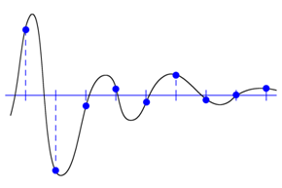
aPeriodic or non-periodic signal :-
A signal x(n) is called aperiodic or non-periodic if there is no time span N , for which X ( n + N ) = x(n) is true for all n. or simply the signal do no repeats its state after any N seconds

Slide 23
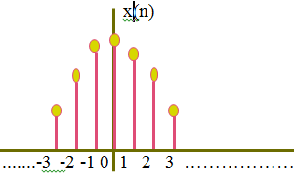
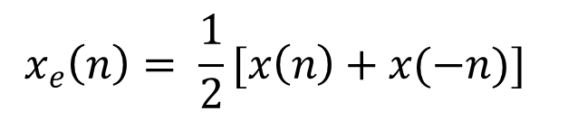
Discuss symmetric(even) signal and asymmetric(odd) signal?
Symmetric(even) signal :-
a real valued signal is said to be symmetric(even) signal if x(-n)= x(n) ……(i) for all n
the even component of a signal is given by ,
$$x_{e}\left(n\right)= \frac{1}{2}[x\left(n\right)+x(−n)]$$

Slide 24
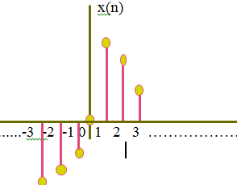
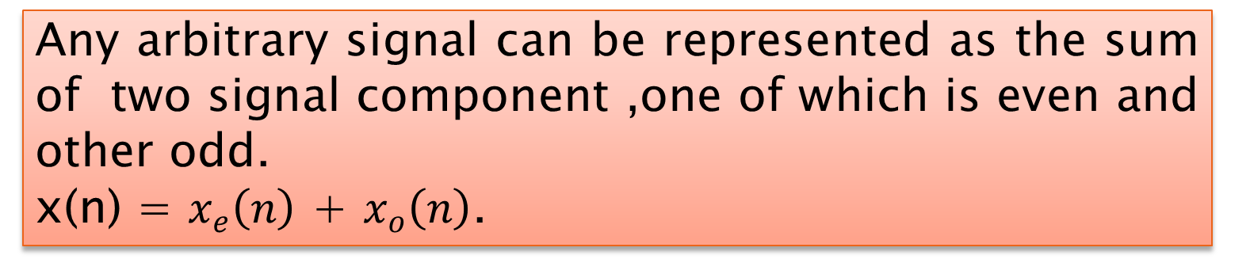
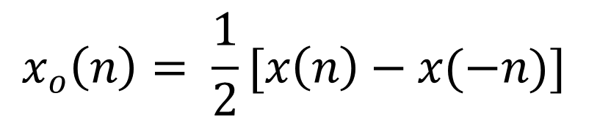
Discuss symmetric(even) signal and asymmetric(odd) signal?
Asymmetric(0dd) signal :-
a real valued signal is said to be asymmetric (odd) signal if x(-n)= -x(n) ……(i) for all n
the even component of a signal is given by
$$x_{o}\left(n\right)= \frac{1}{2}[x\left(n\right)−x(−n)]$$
For odd signal x(0) = 0
Any arbitrary signal can be represented as the sum of two signal component ,one of which is even and other odd.
x(n) = $x_{e}\left(n\right)$ + $x_{o}\left(n\right)$.

Slide 25
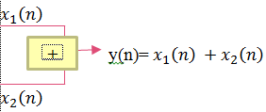
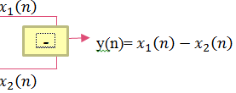
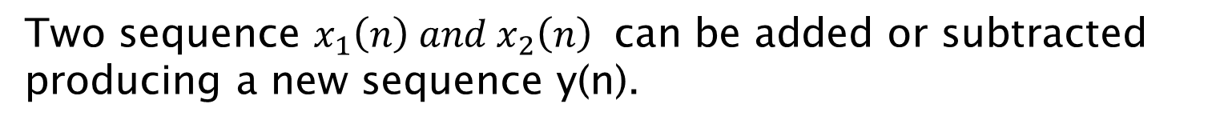
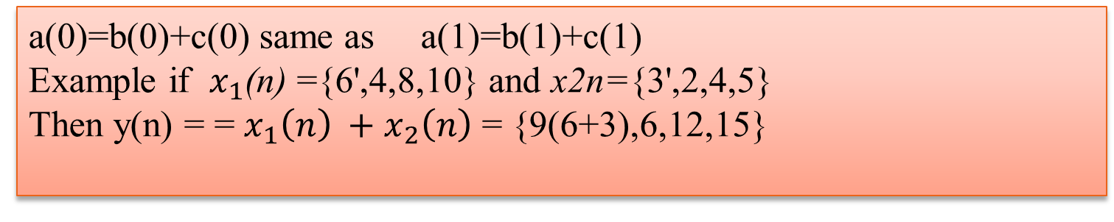
basic operation on discrete time signal
Addition and subtruction
Two sequence $x_{1}\left(n\right) and x_{2}\left(n\right)$ can be added or subtracted producing a new sequence y(n).
a(0)=b(0)+c(0) same as a(1)=b(1)+c(1)
Example if $x_{1}$(n) ={6',4,8,10} and x2n={3',2,4,5}
Then y(n) = = $x_{1}\left(n\right) +x_{2}\left(n\right)$ = {9(6+3),6,12,15}

Slide 26
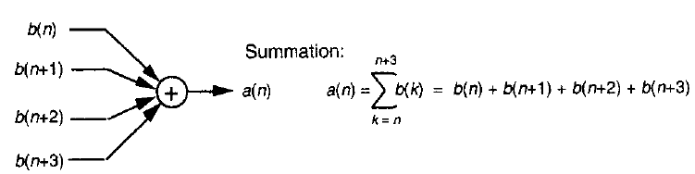
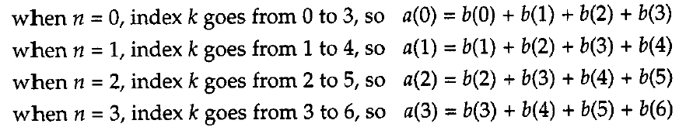
basic operation on discrete time signal
Summation
When we must calculate a sequence whose elements are the sum of more two values.
This means

Slide 27

basic operation on discrete time signal
Multiplication by a constant
We can multiply a given sequence x(n) by a constant a ,resulting in a new sequence y(n) and a may ne positive or negative constant.
if x(n) = {3,2,4,5} and a=2 then y(n) ={6,4,8,10}

Slide 28

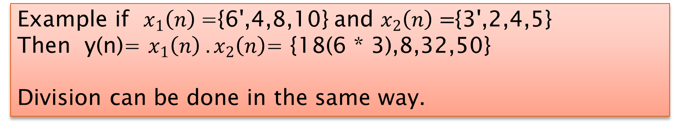
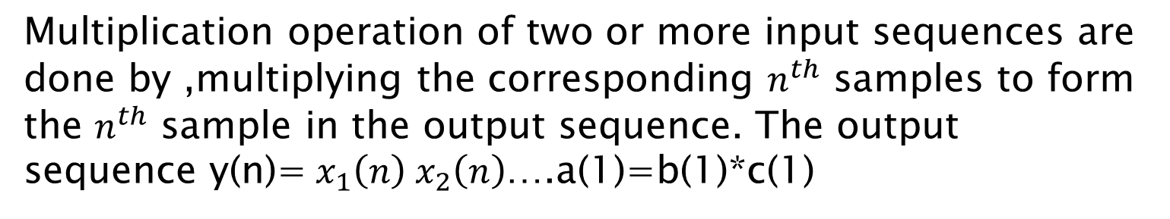
basic operation on discrete time signal
Multiplication operation ?
Multiplication operation of two or more input sequences are done by ,multiplying the corresponding $n^{th}$ samples to form the $n^{th}$ sample in the output sequence. The output sequence y(n)=$x_{1}\left(n\right) x_{2}\left(n\right)$….a(1)=b(1)*c(1)
Example if $x_{1}\left(n\right)$={6',4,8,10} and $x_{2}\left(n\right)=${3',2,4,5}
Then y(n)= $x_{1}\left(n\right) .x_{2}\left(n\right)$= {18(6 * 3),8,32,50}
Division can be done in the same way.

Slide 29
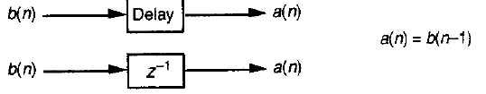
basic operation on discrete time signal
Shifting/ Unit delay operation ?
A signal x(n) may be shifted in time by replacing the independent variable n by (n-k ) ,where k is an integer.
If K is a positive number , the time shift results in a delay of the signal by k units of time, or shifted right by k unites
Output sequence a(n) is equal to a delayed of the b(n) sequence, for example a(5)=b(4) a(6)=b(5) etc.

Slide 30
basic operation on discrete time signal
Two important aspects of digital signal processing.
First, our processing operations are always performed on sequences of individual discrete values
Second the elementary operations themselves are very simple.

Slide 31
System:
A system is a mathematical model of a physical process that relates the input signal to the output signal.
Let x and y be the input and output signals, respectively, of a system. Then the system is viewed as a transformation (or mapping) of x into y. This transformation is represented
By where T is the operator representing some well-defined rule by which x is transformed into y.

Slide 32
Discuss discrete time system
A discrete time system is a device or algorithm that operates on a discrete-time signal, called the input or excitation, according to some well-defined rule and prescribed procedure ,to produce another discrete-time signal called output or response.
Discrete-Time System is a mathematical operation that performs on a given input signal x[n] and convert its corresponding output signal y[n].

Slide 33
The output of a system:
Figure-2 Discrete -Time System
Where, T denotes the transformation operator. x(n) = input signal,
y(n)= output signal

Slide 34
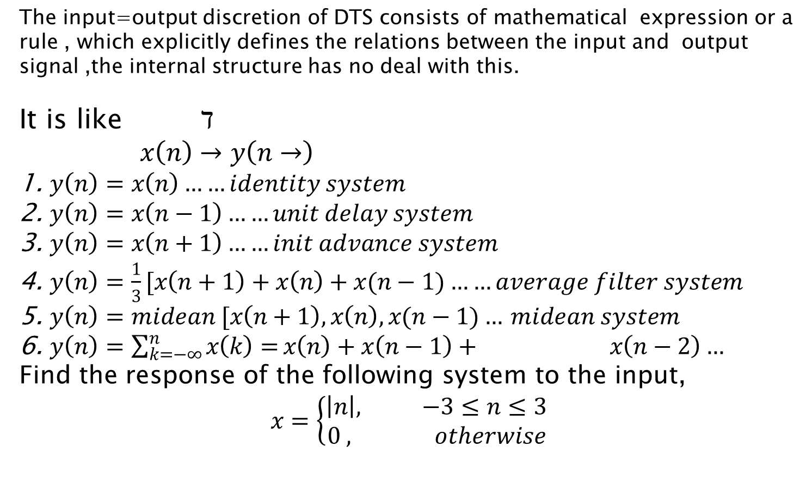
Discuss the input output discretion of DTS
The input=output discretion of DTS consists of mathematical expression or a rule , which explicitly defines the relations between the input and output signal ,the internal structure has no deal with this.
It is like $ℸ$
$x\left(n\right)→y\left(n→\right)$
$y\left(n\right)=x\left(n\right)……identity system$
$y\left(n\right)=x\left(n−1\right)……unit delay system$
$y\left(n\right)=x\left(n+1\right)……init advance system$
$y\left(n\right)=\frac{1}{3}[x\left(n+1\right)+x\left(n\right)+x(n−1)……average filter system$
$y\left(n\right)=midean [x\left(n+1\right),x\left(n\right),x(n−1)…$ $midean system$
$y\left(n\right)=\sum_{k=−∞}^{n}{x\left(k\right)=}x\left(n\right)+x\left(n−1\right)+ x\left(n−2\right)…$
Find the response of the following system to the input,
$$x=\left\{\begin{aligned}\left|n\right|, −3≤n≤3 \\ 0 , otherwise\end{aligned}\right.$$

Slide 35
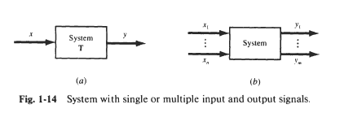
Feedback System:

Slide 36
Feedback System:
When the output of the first system is the input of second system and output of the second system is added to the input of the first system, then this type of connection of systems is called feedback system. Figure 2.37, where the output of system-1 is the input to system-2, while the output of system-2 is fed back and added to the system-1.

Slide 37
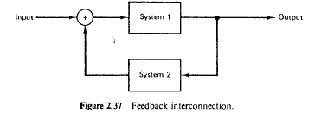

Slide 38
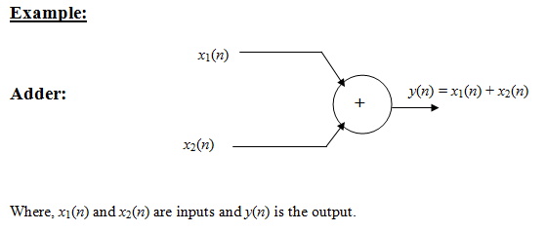
Block Diagram Representation of Discrete-Time Systems
Adder:

Slide 39
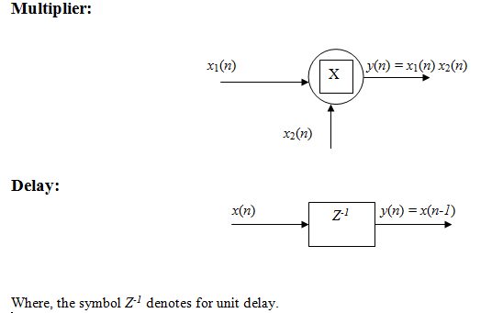
Multiplier & Delay:

Slide 40
Example:
Using the basic blocks, sketch the block diagram representation of the discrete-time system described by the input-output relation
Where, x(n) is the input and y(n) is the output of the system.

Slide 41
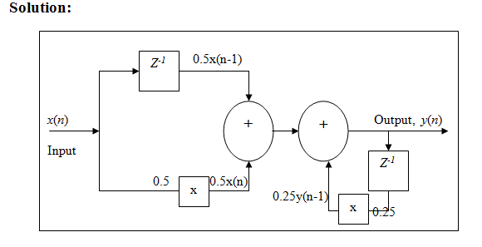

Slide 42
Classification of Discrete -Time System:
Linear System:
Non-Linear System:
Time-Invariant System (Shift – Invariant System):
Time-Variant System:
Static or Memoryless System:
Dynamic System:
Causal System
Non-causal System
Stable System
Linear time-invariant (LTI) system

Slide 43
Linear System:
A linear system is one that satisfies (the superposition principal) the response of the system to a weighted sum of signals (inputs) be equal to the corresponding weighted sum of the responses (outputs) of the system to each of the individual input signals.

Slide 44
A system is linear if and only if
T[ a₁x₁(n) + a₂ x₂(n)] = a₁T[x₁(n)] + a₂T[x₂(n)] [Additivity]
Where,
x₁(n) and x₂(n) are inputs.
a₁ and a₂ are the constants.
T is the operator.
T[ a₁x₁(n)] = a₁T[x₁(n)] = a₁ y₁(n) [Scaling]
Where, y₁(n) = T[x₁(n)]

Slide 45
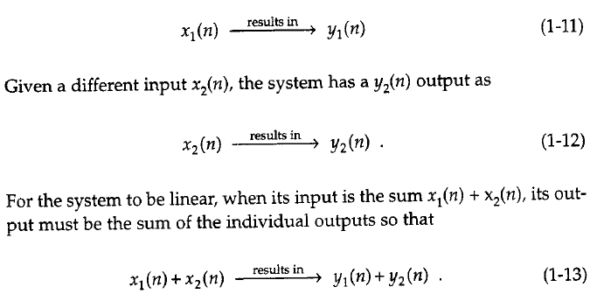
Linear System:
If the input are scaled by constants factor c1 and c2 then output sequence scaled factor same.

Slide 46


Linear non linear system
The system operates on the sum of signals
The system operates on individual signal and the adds the weighted responses.
If both the results are same the system is called linear otherwise the system in nonlinear.

Slide 47


Linear System: Example

Slide 48
Non-Linear System:
If a system produces a nonzero output with a zero input, then the system is called non-linear system. (A non-linear system is one that does not satisfy the superposition principal.)
Example:
y₁(n) = Ax₁(n) + B
Where, x₁(n) is the input, y₁(n) is the output,
A and B are the constants.

Slide 49



Non-Linear System:

Slide 50

Non-Linear System:

Slide 51

Non-Linear System:
Which shown all positive sequence in ceter figure -b

Slide 52


Time-Invariant System (Shift – Invariant System):
A system is called time-invariant system if its input-output characteristics do not change with time.

Slide 53

Time-Invariant System (Shift – Invariant System):
To determine if any given system is time invariant, we need to perform the test specified by the preceding definition. Basically, we excite the system with an arbitrary input sequence x ( n ) , which produces an output denoted as y(n). Next we delay the input equence by same amount k and recompute the output. In general, we can write the output as
Example 1: y(n) = T{x(n)}
Where, T denotes the transformation operator and x(n) is
the input and y(n) is the output of the system
Example 2:
y(n-n₀) = T{x(n- n₀)}
A time shift at the input x(n- n₀) causes corresponding
time-shift at output y(n-n₀).

Slide 54
Time-Variant System:
A system is called time-variant system if its input-output characteristics change with time.
Example 1:
y(n) = x(mn)
Example 2:
Delay the input the output is
y₁(n) = x(mn-n₀)

Slide 55



Static or Memoryless System:
A discrete – time system is called Static or Memoryless system if the output y[n] at every value of n depends only on the input x[n] at the same value of n. but not on past or future samples of the input
If the output of a system at time n is completely determined by the input samples in the interval from n – N to n (N>0), the system is said to have memory of duration N.
If N = 0. the system is static.
If 0 < N <, $∞$ the system is said to have finite memory.
Whereas if $N=∞$, the system is said to have infinite memory.
Example
are both static or memoryless. Note that there is no need to store any of the past inputs or outputs in order to compute the present output

Slide 56

Dynamic System:
A discrete – time system is called dynamic system if the output y[n] depends on present x[n] and past inputs x[n-1].
y(n) = ax(n) + bx[n-1] where, a and b are the constants.
are dynamic systems or systems with memory. The systems described by (2.2.9) and (2.2.10) have finite memory, whereas the system described by (2.2.11) has infinite memory

Slide 57
Causal System
A system is said to be causal if the output of the system at any time n [i.e. y(n)] depends only on present and past inputs [i.e. x(n), x(n-1), x(n-2), x(n-3), .....]. but does not depend on future inputs

Slide 58
The output y(n) = F[x(n), x(n-1), x(n-2), x(n-3), .....]
Where, F[.] is the arbitrary function.
Explanation:
y(n) = x(n) + x(n-1)
Where,
x(n) is the present input
x(n-1) is the past inputs
y(n) is the output.

Slide 59
Non-causal System
A system is said to be non-causal if the output of the system at any time n [i.e. y(n)] depends on present , past inputs and future inputs [i.e. x(n), x(n-1), x(n-2), x(n-3), .... and x(n+1), x(n+2), x(n+3), ...... .].

Slide 60
The output y(n) = F[x(n), x(n-1), x(n-2), x(n-3), ..., x(n+1), x(n+2), x(n+3), ...... .]
Where, F[.] is the arbitrary function.
Explanation:
y(n) = x(n) + x(n-1) + x(n+1)
where x(n) is the present input
x(n-1) is the past inputs
x(n+1) is the future inputs
y(n) is the output.

Slide 61


Determine if the systems described by the following input-output equations are causal or noncausal.

Slide 62
Stable System
Stability (in the sense of bounded-input bounded-output BIBO)
A system is stable if and only if every bounded input produces a bounded output.

Slide 63
Stable System
The condition that the input sequence x(n) and the output sequence y(n) are bounded is translated mathematically to mean that there exist some finite numbers, like M_{x} and M_{y}, such that
׀x(n)׀≤ M_{x} < ∞
׀y(n)׀≤ M_{y} < ∞ for all n.
If. for some bounded input sequence . X (n) . the outpur rs unbounded (infinite), the system is classified as unstable

Slide 64

Stable System

Slide 65
Stable unstable
A system generating an unbounded(infinite) output for a bounded input is termed as unstable system.

